Slide 1
MSIT 3860
Final Project Report
Nithin Rachakonda
70313368

Slide 2
Part 1: Business Presentation

Slide 3
Yelp users since 2010
How many users have joined Yelp each year since 2010?
Joining of users first increased and then decreased every year
No. of users joining Yelp increased from 2010 up until 2015
From 2015 onwards users joining yelp decreased every year
Most joinings happened in the year 2015 - 247850 users
Least joinings happened in 2021 – 40485 (assuming we donnot have the data up until December 31, 2022.)

Slide 4
Elite users since 2012
How many users were elite in each of the 10 years from 2012 through 2021?
Interestingly, the no of elite users is constantly increasing through the years since 2012
There is a slight decrease in the no. of elite users in year 2020 compared to 2019 but this may be due to Covid-19
The craze among the existing users of Yelp is increasing while it is inverted among the new users
The excitement to maintain the previous year’s elite status would have also played a role here

Slide 5
Users with most 5-star reviews
Which of our users has the most 5-star reviews of all time? Give us the person’s name, when they joined Yelp, how many fans they have, how many funny, useful, and cool ratings they’ve gotten. Please also gives us 3-5 examples of recent 5-star reviews they have written
Michael, Marielle and Michelle are Yelp’s top users with most no. of 5-star reviews
Michael and Marielle joined Yelp in 2010
Michelle joined Yelp in 2008
All 3 of them had higher useful votes compared to funny and cool votes
This tells us the 5-star rating highly probable if the review is useful in the eye of the reader

Slide 6
States with most businesses
Which US states have the most businesses in our database? Give us the top 10 states
Pennsylvania has the most no. of businesses - 34039
Florida has the second most businesses - 26330
Almost 45% of all businesses in top 10 states resides in either Pennsylvania or Florida
Tennessee stands at third place with 12056 businesses, less than 50% of businesses Florida has
Next places are holded by Indiana, Missouri, Los Angeles, Arizona, New Jersey, Nevada and California respectively

Slide 7
Top Business Categories
What are our top ten business categories? In other words, which 10 categories have most businesses assigned to them?
Restaurants and Food lead with 80,049 businesses, showcasing high consumer demand in food and dining sector
Shopping ranks third with 24,395 businesses, highlighting significant consumer spending
The presence of Home Services, Beauty & Spas, Health & Medical, and Local Services in the top ten categories represents the importance of service-oriented businesses
Nightlife and Bars, with 12,281 and 11,065 businesses respectively, point to a thriving entertainment and leisure industry

Slide 8
Average Rating of Top Business Categories
What is the average rating of the businesses in each of the top ten categories?
Beauty & Spas have the highest average rating of 3.811, indicating strong customer satisfaction in this sector
Food and Nightlife categories maintain good ratings at 3.669 and 3.656, respectively, suggesting positive experiences in dining and entertainment
Despite being the most populous category, Restaurants have a lower average rating of 3.515, hinting at fierce competition and varying customer experiences
With the lowest average rating of 3.457, the 'Home Services' category is facing challenges in meeting customer expectations

Slide 9
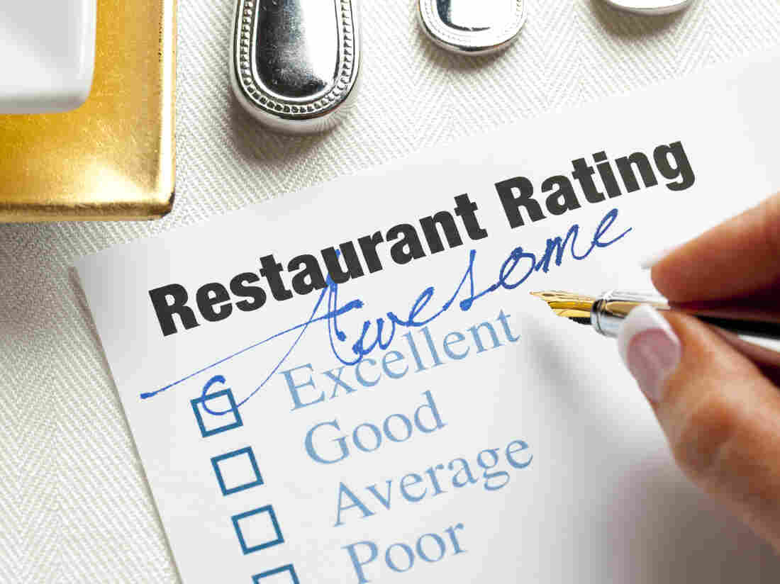
Funniest vs Least Funny Restaurant Reviews
We’re wondering what makes users tag a Restaurant review as “funny”. Can you give us 5 examples of the funniest Restaurant reviews and 5 examples of the 10 least funny? We’d also like you to look at a larger set of funny and unfunny reviews and tell us if you see any patterns that separate the two.
Funny reviews often contain a mix of sarcasm, hyperbole, and vivid storytelling, making them more entertaining to read and are providing a narrative-like account of the dining experience
Least funny reviews, on the other hand, stick to basic details about food quality, service, and atmosphere without diving into storytelling
The funny reviews often focus on negative experiences but present them in a humorous or exaggerated way
Least funny reviews, while they may also mention negative aspects, do so in a more matter-of-fact manner
Funny reviews tend to be longer and more complex, while the Least funny reviews are typically shorter and more to the point
Note : The reviews are very long to display in the presentation, so I have included them in a csv file in the zip file

Slide 10
Length vs Compliments
We think the compliments that tips receive are mostly based on how long the tip is. Can you compare the average length of the tip text for the 100 most-complimented tips with the average length of the 100 least-complimented tips and tell us if that seems to be true?
The top 100 most-complimented tips have an average length almost 3 times to that of the bottom 100 least-complimented tips
This suggests that longer tips are more likely to receive compliments
The longer average length of the top 100 tips implies that providing more detailed information tends to be more valued by the audience
Overall, the data suggests that customers appreciate comprehensive insights or advice, which is reflected in the number of compliments received

Slide 11
Restaurant reviews are driven by…
We are trying to figure out whether restaurant reviews are driven mostly by price range, how many hours the restaurant is open, or the days they are open. Can you please give us a spreadsheet with the data we need to answer that question?
I could not see no of days impacting the no. of reviews
The data is almost random
So, it is safe to say that the number of days or the timings of the restaurant does not play a huge part on accumulating the number of reviews

Slide 12
Part 2: Personal Presentation

Slide 13
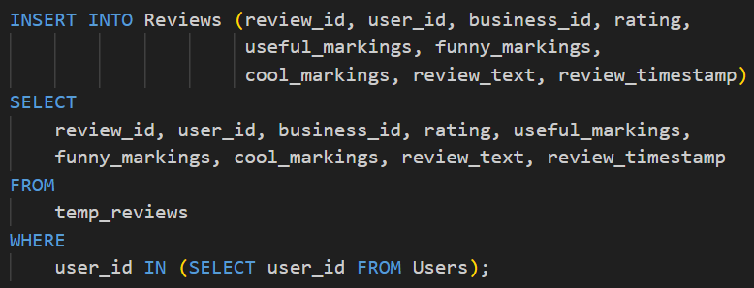
The Challenge
What was your biggest challenge in working with this data? How did you overcome it?
Challenge Encountered: Faced "foreign key violation" error during data insertion into reviews table because there were user_ids in the reviews data which were not in the users data
Solution: Created "temp_reviews“ table without foreign keys and inserted the reviews data in this table
Selective Data Transfer: Transferred data to reviews table from temp_reviews using WHERE condition for matching user_ids : WHERE user_id IN (SELECT user_id IN USERS)
Outcome: Successfully resolved issue, maintaining database integrity and relational structure

Slide 14
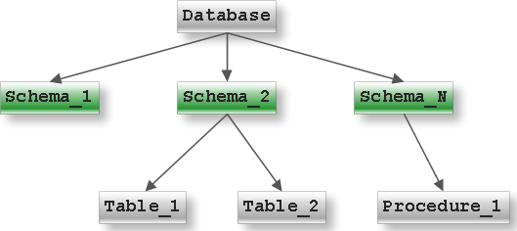
The Easy Part
What was the easiest part of the project for you? What made it easy?
Creating the database and building the tables was the easiest part in the project in my perspective
How to write the Schemas efficiently and correctly were clearly explained during the classes
Personal practice on building different types of tables gave me the experience and confidence to build the schema precisely
The well lectured classes by prof. Augustyn combined with personal practice sessions made it easy for me while coming to building the schema for the tables that were used in the project

Slide 15
The Surprising Part
Was there anything that surprised you about the data?
There were two columns in the Users data that were exactly similar i.e., same data for every row
“Number of cool compliments received by the user” and “Number of funny compliments received by the user” are those two attributes
What was surprising is that a company as big as Yelp has a complete redundant attribute in its database
Maybe there was a glitch or maybe both are seen as a same compliment
Regardless of that I have just ignored the fact that they both have similar data and continued with the project without trying to change the data
Cool_Compliments posses
Exactly the same data as
Funny_compliments

Slide 16

Real Data of Yelp
Is there anything you wonder about how Yelp’s real data might look, how their database systems are designed, or what they do with this kind of data?
I wonder how big the actual database of Yelp would be
The sample database that I worked had large amount of data, reviews data had almost 7 million rows
So, I can only imagine how much data the actual Yelp database have
I think their databases are designed with as many constraints possible to overcome any data redundancies or inefficiency of their database
I strongly think that Yelp regularly analyses their database to get meaningful insights which can be used by the policymakers of the company to improve the profits of Yelp

Slide 17

Recommendations
Are there any changes you would recommend to Yelp to make this data easier to work with?
As I previously mentioned, having good constraints helps the database to be more efficient and to be of better quality
I observed need of a constraint that I did not need to put in place but is a need for a live and ongoing transactional database
There is a need to ensure the the average_review in Users is consistently updated when new reviews are added
This can be done by a procedure or a trigger. I would recommend a procedure because reviews will be added frequently and a trigger working frequently might reduce the speed of the database.
Other than this I would also ask Yelp to look at its funny_compliments and cool_compliments attributes in the User table as both of them have same data.

Slide 18
THANK YOU

